Slide 1
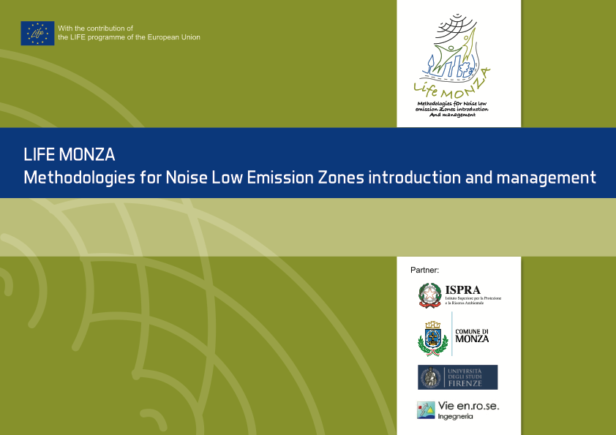
Raffaella Bellomini (Vie en.ro.se. Ingegenria – Firenze – Italy)
Rosalba Silvaggio (ISPRA - Italian National Institute for Environmental Protection and Research)
Sergio Luzzi - Vie en.ro.se. Ingegneria - Firenze - Italy
Francesco Borchi (Department of Industrial Engineering – University of Florence)
ACOUSTICS ‘17
BOSTON, 25-29 JUNE 2017
Notes:
Today I’ll present a project, actually ongoing in Italy, in the city of Monza in the northern part of the peninsula, focussed on the objective to define a method to set up and manage a NOISE LOW EMISSION ZONE.
The project is co-funded by the European Union, under the programme LIFE ENVIRONMENT.
The project is called MONZA, that is the acronym for Methodologies for Noise Low Emission Zones introduction and management.

Slide 2
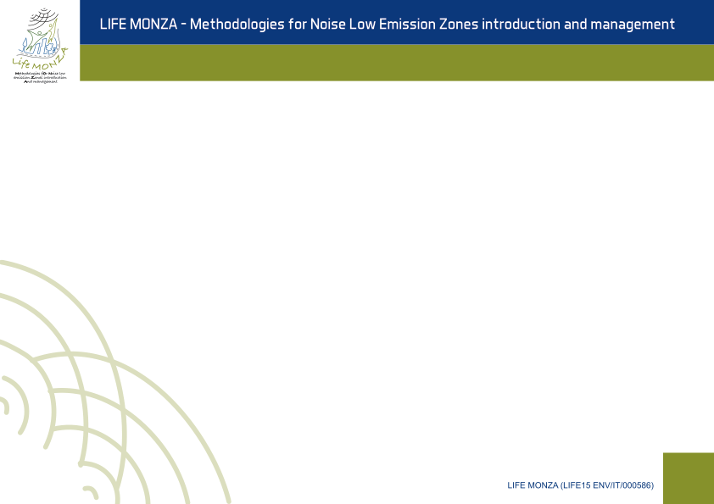
SCOPE
The introduction of Low Emission Zones, urban areas subject to road traffic restrictions in order to ensure compliance with the air pollutants limit values, set by the European Directive on ambient air quality (2008/50/EC), is a common and well-established action in the administrative government of the cities and the impacts on air quality improvement are widely analyzed, whereas the effects and benefits concerning the noise have not been addressed in a comprehensive manner.
The definition, the criteria for analysis and the management methods of a Noise Low Emission Zone are not yet clearly expressed and shared.
LIFE MONZA project (Methodologies fOr Noise low emission Zones introduction And management - LIFE15 ENV/ IT/000586) addresses these issues.
The key points on which the project is based are:
it's easier to change a town than a nation
2) Change can start at the civic level
1
Notes:
All of you know what the low emission zones are.
Low emission zones (LEZs) have been spreading across the globe. Low Emission Zones (LEZs) are areas where the most polluting vehicles are regulated. Usually this means that vehicles with higher emissions cannot enter the area.
In some low emission zones the more polluting vehicles have to pay more if they enter the area.
Low Emission Zones are known with different names, as:
Environment Zones,
Umweltzonen in Deutschland
Milieuzones in France
ZTL ambiente in Italy
Cities introduce NOISE LOW EMISSION ZONES to controlling air pollution by banning vehicles that contaminate the most. In Europe, civic governments are beginning to taking steps in the name of air quality.
Some example: The First: Tokyo
In 2001, Tokyo began to implement a program to clean up diesel-powered commercial vehicles. The ordnance required the retrofitting of older trucks and busses with particulate matter filters. Diesel mixed with heavy oil was banned. Idling while loading and unloading was prohibited. Any business with over 30 vehicles must have an environmental management plan in place. Businesses with over 200 vehicles must have a certain percentage of low emission vehicles.
Later on in 2003, Tokyo officially created its first LEZ.
The Most: Germany
Over 200 European cities currently have or are implementing Low Emissions Zones. The European Union has a protocol for cleaning up emissions (also known as the European Emission Standards). Incrementally, all vehicles sold in the EU should meet increasingly stricter regulations.
Germany has over a third of the LEZs in Europe. The plan began in 2008 after Germany failed to meet European air quality standards. Failure to have the proper standard required earns a 40 euro fine.
The Biggest: London
Beginning in 2008, a LEZ was placed over most of the city of London, which has some of the worst air in Europe. It mostly targets the heaviest diesel vehicles. The administration is aiming to continue improving the city's automobiles until it will be established an Ultra-Low Emissions Zone by 2020. Already the $15.50 congestion charge for most fuel-burning vehicles has encouraged Londoners to purchase electric city cars.
The law is enforced by a system of Automatic Number Plate Recognition Cameras. Signs around the city indicate when drivers are about to enter the zone, remind them they are being watched and suggests detours to avoid the LEZ.
The Strictest: Italy
Italy in certain cases goes above and beyond the European standard. Several Italian cities have Restricted Traffic Zones where all motor travel is banned during certain hours. Misinformed drivers can receive a fine for every time they pass a traffic camera. They can be ticketed, without being stopped by the police, for simply driving a high-emission vehicle in the wrong place. Additionally, restrictions apply in some cities to vehicles over 7.5 meters and two stroke motorbikes. In some places daily charges are applied to all gas or diesel vehicles with more than two wheels.
MONZA Projects move from the issue that, while the LEZ introduction impacts on air quality improvement are widely analyzed, the effects and benefits concerning the noise have not been addressed in a comprehensive manner.
Moreover, the starting point of project partners, is the idea that it's easier to change a town than a nation and that change can start at the civic level.

Slide 3

First OBJECTIVE
The main objective of the project is to introduce an easy-repeatable method, and related guidelines, for the identification and the management of the Noise Low Emission Zone, an urban area subject to traffic restrictions, whose impacts and benefits regarding noise issues will be analyzed and tested in the pilot area of the city of Monza, located in North Italy
1°
2

Slide 4
Further OBJECTIVES
The second objective regards specific top-down measures, adopted by the municipality and able to turn up the area in a permanent Noise LEZ, concerning infrastructural interventions
2°
3°
The third objective is to reduce the average noise levels in the pilot area of Libertà district, with positive complementary effects also on the air quality and benefits on wellbeing conditions of inhabitants
The fourth objective is to involve the population in an active management system (bottom-up measures) of lifestyle choices
4°
4

Slide 5
Dialogue between citizens and public bodies
top-down measures adopted by the municipality and able to turn up the area in a permanent Noise LEZ, concerning:
traffic management (limitation of the vehicles speed and prohibition access to trucks);
road paving substitution;
introduction of two pedestrian crossings
bottom-up measures: people will be involved in an active management system of a more sustainable lifestyle choices, related to the reduction of noise and the improvement of air quality and wellbeing conditions, in their living and working environment. In order to encourage the local community involvement and to strengthen the dialogue between citizens and public bodies, many activities will be carried out, as:
meetings in primary and high schools, in order to raise awareness about noise effects;
ideas contests for Noise LEZ picture and logo;
questionnaires on quality of life and noise and air quality perceptions;
use of the mobile App, developed throughout the course of the project, devoted to manage voluntary and sustainable actions carried out by citizens.
5
Notes:
The whole project is focused on proposing activities involving dialogue between public administration and citizens.
The actions that will be implemented in the project are divided into two main groups:
TOP DOWN MEASURES
BOTTOM UP MEASURES
Top down measures are those adopted by the municipality, formally necessary to turn up the area in a permanent noise LEZ and able to improve, in the area, the acoustic climate and air quality as well.
In the pilot area actions for traffic management are foreseen (for example limitation of the vehicles speed and prohibition access to trucks, road paving substitution and introduction of pedestrian crossing.
Bottom up measures are those where people involvement is essential to success in the expected goals. In bottom up measures people will be involved in an active management system of a more sustainable lifestyle choices, related to the reduction of noise and the improvement of air quality and wellbeing conditions, in their living and working environment.
The challenge is to discover and build together the “genius loci” of the area, defining a territorial identity of the noise LEZ area, through initiatives able to design a part of the city and to share new lifestyle choices.
INAD - during the Noise Awareness day of April 2017, meetings have been organized in the primary and high schools located in Libertà district to raise awareness in students about noise and a sustainable home – school mobility system.
Ideas contest in the high schools, about a new logo for identifying noise LEZ and good practices to reduce noise in the area is going to be launched in September.
Ideas contest in primary schools about a picture for identifying noise LEZ, possible good practices to reduce noise in the area will also be opened in September.
development of an application for mobile and pc, to manage voluntary actions and to “measure” benefits and concrete changes in people lifestyle, to be transposed in a bonus for citizens.

Slide 6
Contribution of the project to policy implications at different levels
European Level
In order to contribute to the implementation of the European directives, avoiding duplications and overlaps, potential synergies existing between the issues related to noise pollution and air quality will be investigated during the project.
The methodology will contribute to the implementation of the EU Directive 2002/49/EC, related to the assessment and management of environmental noise (Environmental Noise Directive - END), which introduces noise action plans, designed to manage noise issues and effect, including noise reduction if necessary.
6
Notes:
The MONZA project aims to. contribute to the implementation of environmental policies at European, national and local level.
At European Level the methodology will contribute to the implementation of the EU Directive 2002/49/EC, related to the assessment and management of environmental noise (Environmental Noise Directive - END), which introduces noise action plans, designed to manage noise issues and effect, including noise reduction if necessary

Slide 7
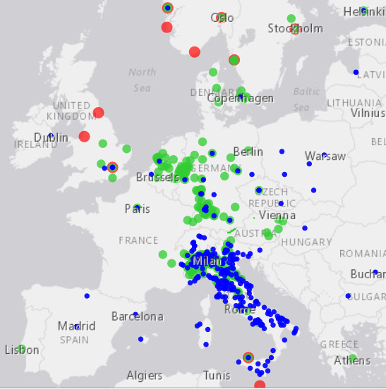
Contribution of the project to policy implications at different levels
European Level
LEZs have been implemented in more than 200 cities in Europe and they are the most common measures adopted in EU, considering traffic planning.
EU Directive 2008/50/EC on ambient air quality and cleaner air for Europe considers the establishment of LEZ a measure to be adopted in air quality action plans.
The EU 2002/49/EC Environmental Noise Directive (END) does not provide a definition of LEZ in relation to noise and it is not considered as an action to take into account in noise action plans drafting.
There is the need of synergies and LIFE MONZA project, aiming at providing management criteria of LEZ, related to noise, will contribute to the implementation of noise action plans set out in Annex V of the END Directive
Source: http://urbanaccessregulations.eu/
7°
Notes:
LEZs have been implemented in more than 200 cities in Europe and they are the most common measures adopted in EU, considering traffic planning.
EU Directive 2008/50/EC on ambient air quality and cleaner air for Europe considers the establishment of LEZ a measure to be adopted in air quality action plans, whereas The EU 2002/49/EC Environmental Noise Directive (END) does not provide a definition of LEZ in relation to noise and it is not considered as an action to take into account in noise action plans drafting.
Monza project is going to encourage this lacking synergies, providing management criteria of LEZ, related to noise, so contributing to the implementation of noise action plans set out the END Directive

Slide 8
Contribution of the project to policy implications at different levels
National Level
Harmonization and simplification process among transposition decrees of EU Directives concerning noise and air pollution; definition of a proposal of a common method for NLEZ, as a proposal to be adopted by a national decree.
Local Level
Availability of a common procedure for Noise LEZ able to make the cities more sustainable; more knowledge about impacts and benefits due to NLEZ introduction; implementation of EU Directives at local level; enforcement of the dialogue between public institutions and citizens.
Source: http://urbanaccessregulations.eu/
8
Notes:
At national level, the goal is the proposal of a decree establishing common method for Noise Low emission zones, to be adopted at italian level.
At local level, we think that the availability of a shared procedure for Noise Low Emission Zones able to make the cities more sustainable, could create a virtuous circle in people's lifestyles, because citizens are involved at different levels in each stage of the project

Slide 9
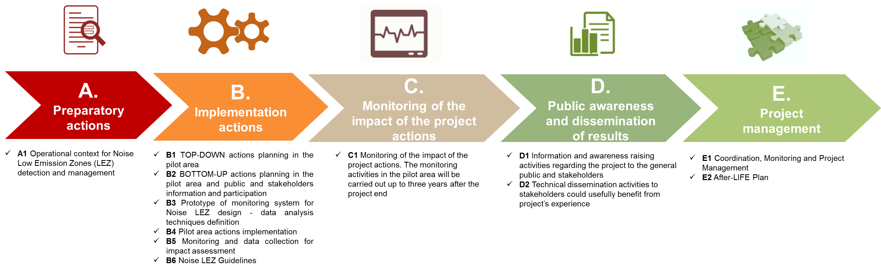
THE PROJECT
1
Notes:
In this image you can see the organizational structure of the project.
Actions A concern the updating of the currently available environmental and legislative framework on monitoring systems for noise and air quality, health indicators, etc. with regards to the noise LEZ context.
Action B regard the pilot area implementation actions, enclosing the detailed designing of top down and bottom up actions. In particular, tasks are dedicated to the infrastructures actions (silent asphalt designing, LEZ formal introduction, actions to limit high vehicles transit), to the detailed designing of bottom-up actions and methods to be applied in order to actively involve citizens in the project. Moreover, B actions will be dedicated to the designing of monitoring systems (e.g. a prototype system for smart monitoring activity of noise), techniques for the data analysis and restitution and to all the ante and post-operam monitoring activities with specific attention to road traffic, noise, air quality and health. Finally, Action B regard the drafting of guidelines for the introduction and management of Noise LEZ
Action C regards the monitoring of the impact of the projects action to be carried out both during the project and for three years after its conclusion. In order to
ensure the compliance with the demonstrative character of the Project as well as its management,
Actions D and E are respectively planned to guarantee adequate communication and dissemination activities and a good project management as well

Slide 10
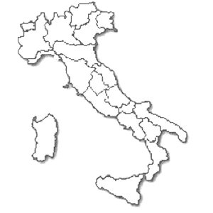



Project location and beneficiaries
PROJECT LOCATION: ITALY - MONZA, Lombardia
The project started on 1st September 2016 and the completion date is scheduled for 06.30.2020
PROJECT Beneficiaries
Coordinating Beneficiary: ISPRA
Italian National Institute for Environmental Protection
and Research
Associated Beneficiaries: MONZA Municipality
UNIVERSITY of FLORENCE
Vie en.ro.Se. Ingegneria srl
3

Slide 11

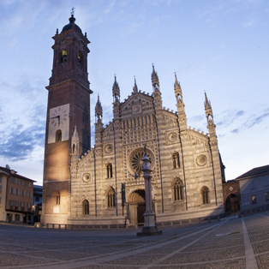
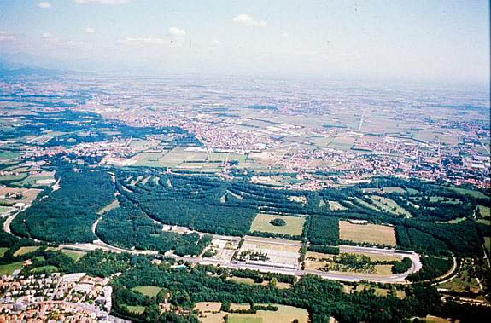
Monza Municipality
10
Courtesy Monza Municipality http://www.comune.monza.it/it/#0

Slide 12
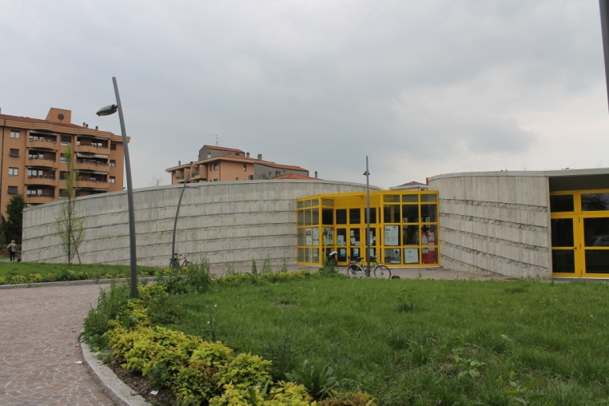
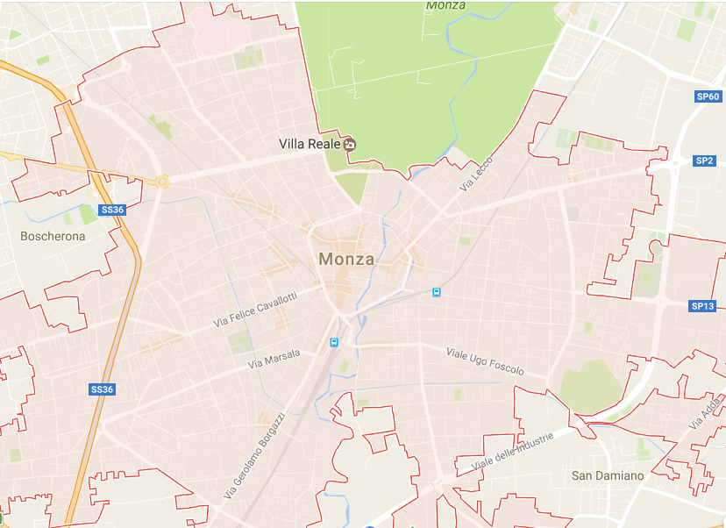
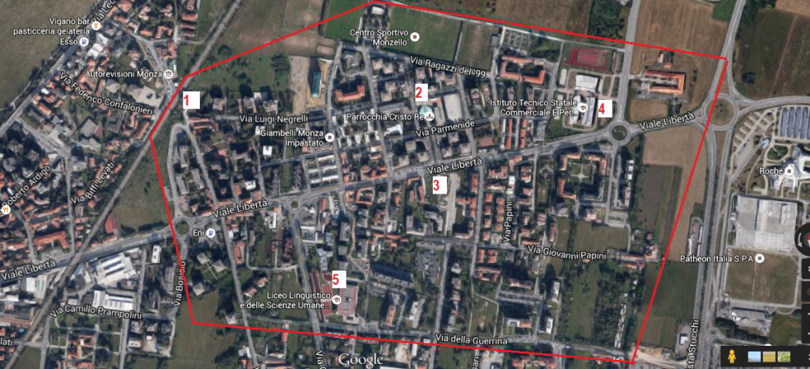
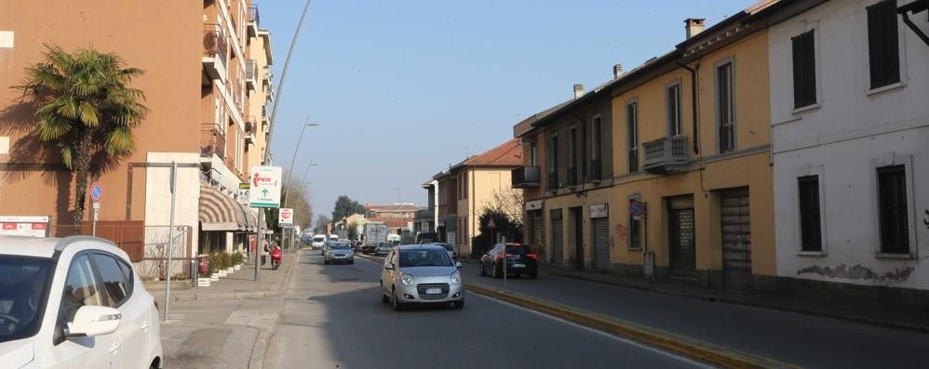
Pilot area in Monza Municipality
Pilota area – Monza Municipality – Libertà District
11
Courtesy Monza Municipality

Slide 13
Pilot area in Monza Municipality
Significant average levels of noise pollution affect a large number of citizens so that Libertà district is identified as a hotspot in the Action Plan of the city of Monza.
Noise strategic map of the city of Monza, dated 2012, highlights that in a range of 30 m from the Viale Libertà almost the 100% of the receivers is exposed to levels higher than 65 dB(A) during the day and 55 dB(A) during the night.
12
Notes:
As told before, one of the objectives is reducing average noise level in the pilot area.
The pilot area is the Libertà district, where about 15000 citizens live, almost totally affected by high noise levels
Consider that about one hundred percent of the population is exposed to levels higher than 65 dB(A) during daytime and higher than 55 dB(A) during nightime.

Slide 14
Monitoring activities and methods tested in pilot area
Objective: reduction of the average noise levels in the pilot area of Libertà district, with positive complementary effects also on the air quality and benefits on wellbeing conditions of inhabitants.
Priority will be given to actions for noise reduction, but attention will be also focused on the improvement of the air quality and citizens’ quality of life.
Noise Monitoring
Traditional equipment
Smart low-cost sensors
Air Quality Monitoring
EU Directive requirements
Passive sampling
Quality of life
Questionnaire
9
Notes:
With reference to ongoing activities, ante-operam monitoring is currently underway.
This monitoring regards
Noise
Air quality
Quality of life

Slide 15
Monitoring methods and activities tested in pilot area
Air Quality Monitoring
EU Directive requirements
Passive sampling
Air Quality monitoring within the pilot area is ongoing, according to requirements provided by Directive 2008/50/EC on ambient air quality and cleaner air for Europe
Also, the low cost and easy operation of the diffusive sampling technique is used for a large scale air pollution surveys with a high spatial resolution.
In order to compare the spatial variability of air pollution before and after the noise LEZ implementation, NO2 and benzene land use regression models in a defined urban area of Monza, including the noise LEZ, will be developed.
The objectives of monitoring will be to assess whether the implementation of the noise low emission zone contributes, as an ancillary effect, to reduce air pollution levels in the pilot area.
13
Notes:
Air Quality monitoring is actually ongoing, by the diffusive sampling technique.
In order to compare the spatial variability of air pollution before and after the noise LEZ implementation, NO2 Nitrogen dioxide and benzene land use regression models in a defined urban area of Monza, including the noise LEZ, will be developed.
The objectives of monitoring will be to assess whether the implementation of the noise low emission zone contributes, as an ancillary effect, to reduce air pollution levels in the pilot area

Slide 16
Monitoring methods and activities tested in pilot area
Quality of life
questionnaire
Regarding the monitoring of the quality of life, a two-step survey will be performed: before and after the institution of the noise LEZ zone.
The use of the WHOQOL-Bref questionnaire, that is the only tool that has a specific environmental domain and it is already validated in Italian language, has been proposed and shared.
14
Notes:
Regarding the monitoring of the quality of life, a two-step survey will be performed: before and after the institution of the noise LEZ zone to more or less 2000 people
The initiative of introducing in the project a quality of life assessment arose for a number of reasons, in particular for the promotion of an holistic approach to environment, health and health care. In recent years there has been a broadening in focus in the measurement of health, beyond traditional health indicators, to include measures of the impact of disease and impairment on daily activities and behaviour.
These measures, whilst beginning to provide a measure of the impact of disease, do not assess quality of life per se, which has been aptly described as "the missing measurement in health“.
By calling for quality of life assessments in health care, attention is focused on a humanistic element into health care, and resulting interventions will pay increased attention to this aspect of patients' well-being.
The questionnaire proposed is the WHO Quality Of Life –Brief questionnaire, that is the only tool that has a specific environmental domain and it is already validated in Italian language, has been proposed and shared.

Slide 17
Noise Monitoring in pilot area
Noise Monitoring
Traditional equipment
Smart low-cost sensors
Regarding the noise monitoring phases planned in pilot area, the activities will be carried out referring to the standard methods, using sound level meters of class I precision, and also by developing and using a smart low-cost monitoring system.
16
Notes:
Regarding the noise monitoring phases actually ongoing in the pilot area, the activities have been carried out referring to the standard methods, using sound level meters of class I precision, and also by developing and using a smart low-cost monitoring system.

Slide 18
Noise Monitoring in pilot area
Regarding the smart low-cost monitoring system a prototype system for smart monitoring activity of noise has been designed and implemented, in order to be used as a continuous monitoring unit in the ex ante and ex post scenarios. In particular, in the last months the state of the art about smart noise monitoring systems has been defined by ISPRA, while smart monitoring system design and data analysis procedures have been performed by UNIFI.
UNIFI is developing the procedures for in situ calibration check and verification of the noise monitoring system performance.
The system check will be performed by UNIFI for a first time period (2 months) before the monitoring period start and by UNIFI/VIENROSE for a second time period (2 years: 1 year in the ante-operam scenario and 1 year in the post-operam scenario) during the monitoring period.
After the end of LIFE MONZA project, the prototype will be given for free to Municipality of Monza that will take care of using it for monitoring activities in the three years after the project end.
17
Notes:
Regarding the smart low-cost monitoring system a prototype system for smart monitoring activity of noise has been designed and implemented, and in these days University of Florence is is developing the procedures for in situ calibration check and verification of the noise monitoring system performance

Slide 19
Smart low-cost noise monitoring system – LIFE MONZA
Smart low-cost noise monitoring systems, allowing an extensive and long-term noise monitoring, in medium sized territorial scale as urban area, seem to be able to ensure an appreciated quality output measurement data. 10 monitoring stations are expected to be installed in the pilot area of Libertà district.
19
Notes:
In this picture you can see the Libertà district, and the red dots indicate the measurements points

Slide 20
Smart low-cost noise monitoring system – LIFE MONZA
Conclusions and future works about the Smart Noise Monitoring System developed in the MONZA project
- Optimization of stability check procedures
- Long term test implementation
- Analysis of long term test results
23
Notes:
Conclusions and future works about the Smart Noise Monitoring System developed in the MONZA project, regard:
- Optimization of stability check procedures
- Long term test implementation
- Analysis of long term test results

Slide 21

CONCLUSIONS
The LIFE MONZA project aims to define a guideline describing a procedure applicable in different contexts for the definition, the identification and the management of a Noise LEZ.
In the project will be implemented and tested intervention techniques strongly involving the population.
Within the project activities, implementation and testing of a new low noise monitoring system will be carried out and tested in the pilot area in the long period, also after the project’s end.
For the monitoring of the environmental impact in the pilot area, indicators will be set taking into account both the noise and air quality as well as the welfare conditions of the population.
23
Notes:
I’m going to general conclusion:
The LIFE MONZA project aims to define a guideline describing a procedure applicable in different contexts for the definition, the identification and the management of a Noise LEZ.
In the project will be implemented and tested intervention techniques strongly involving the population.
Within the project activities, implementation and testing of a new low noise monitoring system will be carried out and tested in the pilot area in the long period, also after the project’s end.
For the monitoring of the environmental impact in the pilot area, indicators will be set taking into account both the noise and air quality as well as the welfare conditions of the population.

Slide 22

Monitoring methods and activities tested in pilot area
Thank you for your kind attention
raffaella.bellomini@vienrose.it
With the contribution
of the LIFE Programme of the European Union
24

